Slide 1
Logo
Page Title
You (or login)
Poll/Content Here
Notes:
General Page Template/heading

Slide 2
PollBuddy Sitemap
2/4/2020

Slide 3
Logo
Welcome to PollBuddy!
User info
DONE
PollBuddy is an interactive platform for educators to connect with students in a virtual classroom.
Enter Poll Code
Notes:
Homepage
Neha

Slide 4
Logo
Login
Sign up
DONE
Email
Password
Forgot Password?
Submit
No account? Sign up
Notes:
Login
Neha
When you log in with an rpi email it sends you to the rpi login page on the rpi website

Slide 5
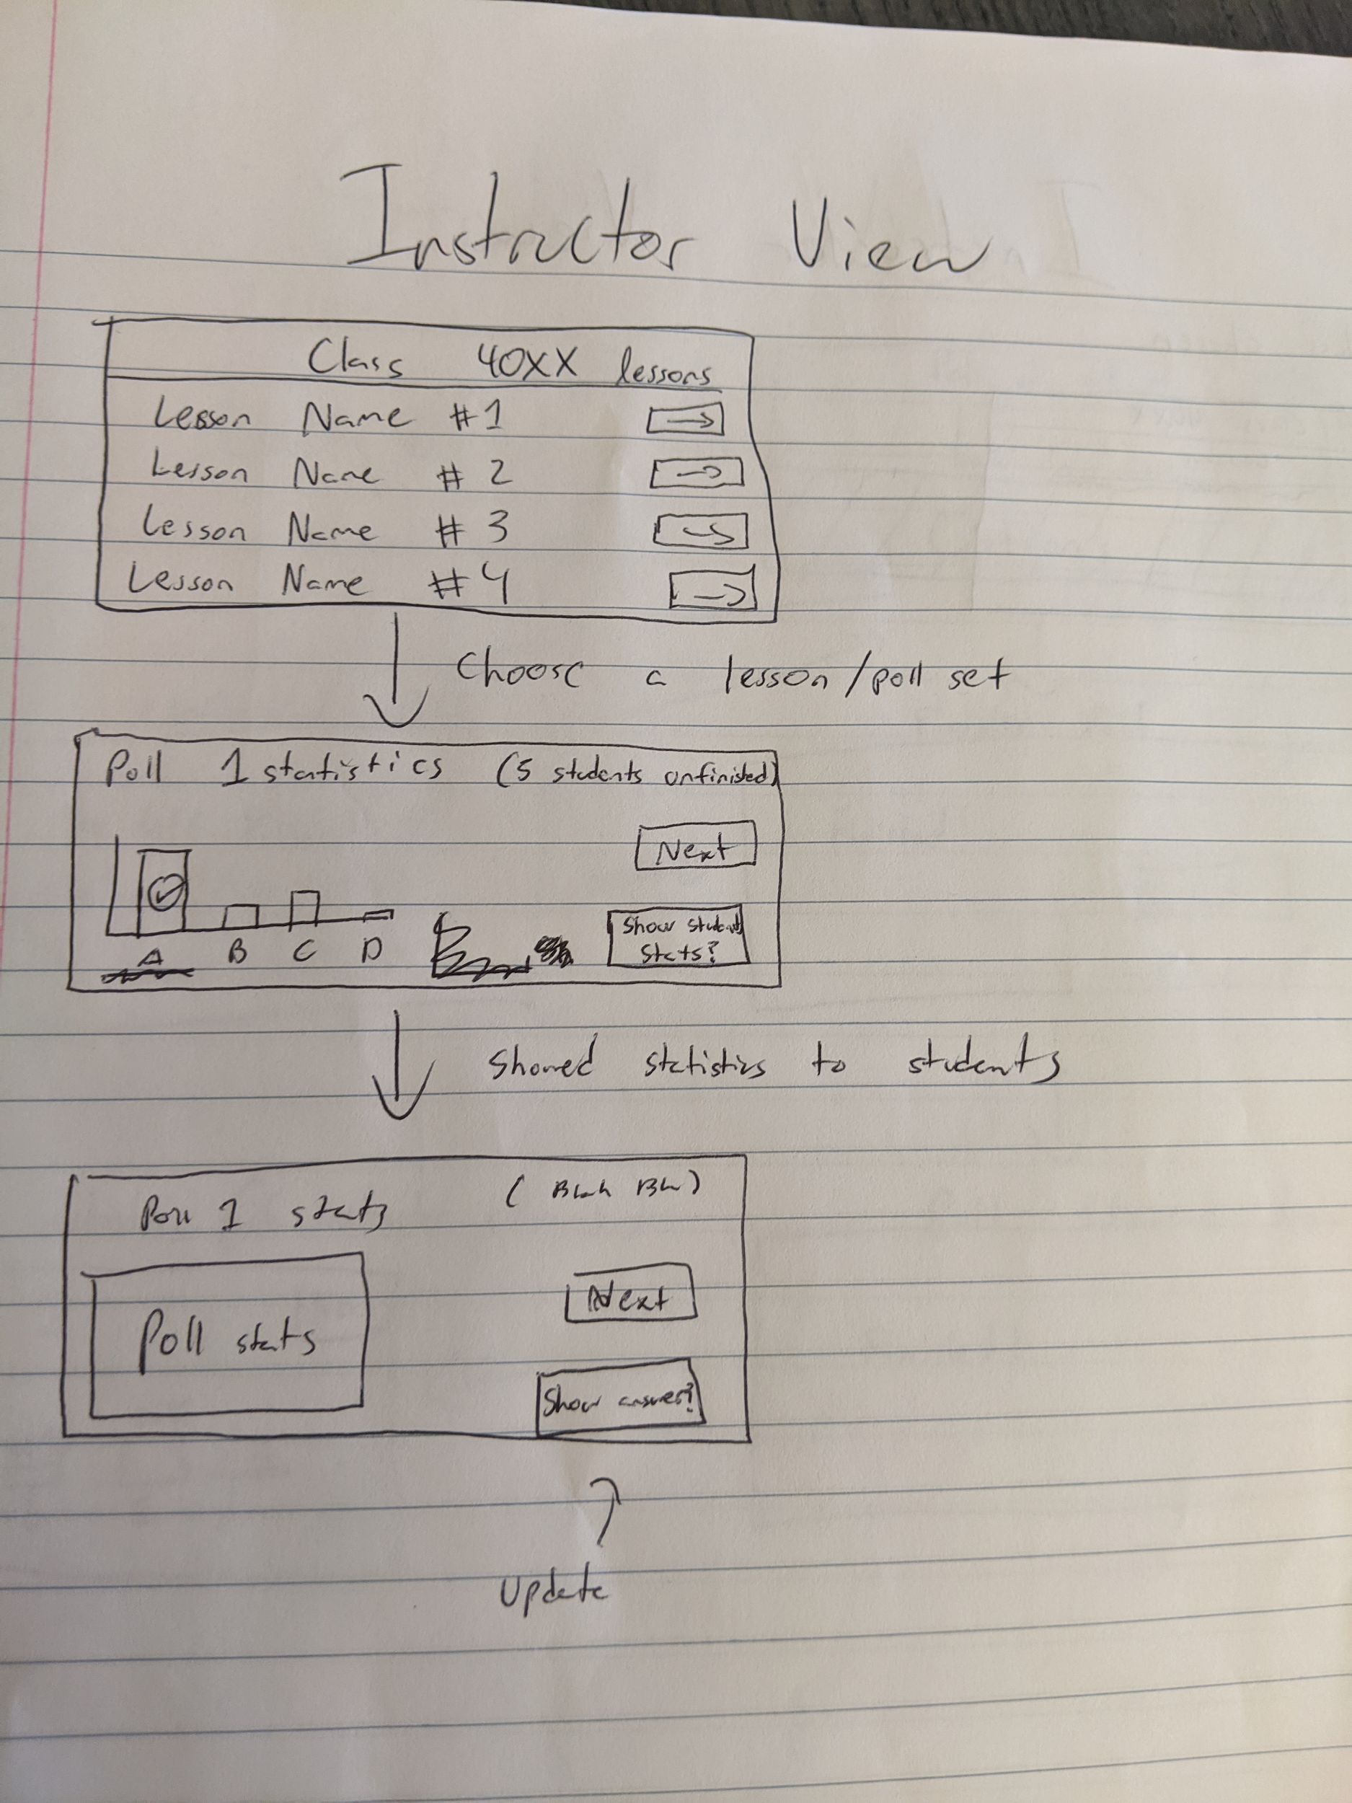
Notes:
Instructor View
Kevin Lee

Slide 6
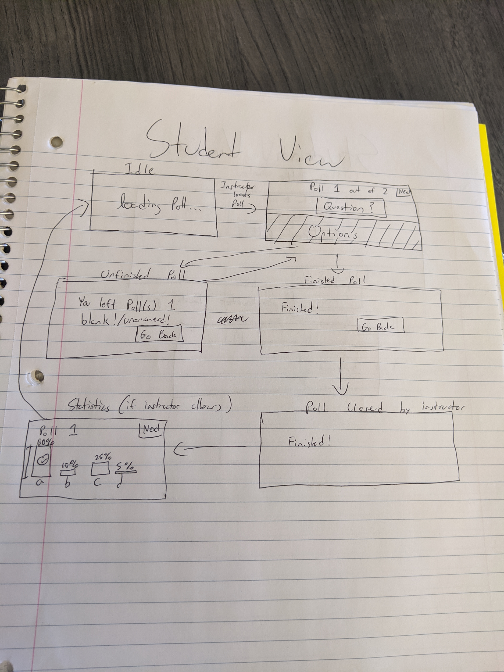
Notes:
Student View
Kevin Lee

Slide 7
Logo
Account Info
User info
Name:
DONE
(text box btw) (autofilled)
Email:
(autofilled)
Current password:
(always required)
New password:
(only fill in if you want to change it)
Confirm password:
(Come up with some better message tho ^)
Save
Notes:
Account info
Ashwin

Slide 8
http://scer.rpi.edu/sites/default/files/Brand-Guidelines-Accessibility.pdf
Notes:
Accessibility

Slide 9
Logo
Contact Us
User info
REMOVED
RCOS Logo Hyperlink
Pollbuddy Logo
GitHub Link
Team Contact
(Email?)
Notes:
Contact us
Ashwin

Slide 10
DONE
Enter Poll Code
Go!
(Might change “Go!” to “Join poll” or “Join class”)
Notes:
Enter Poll code page (Joe)

Slide 11
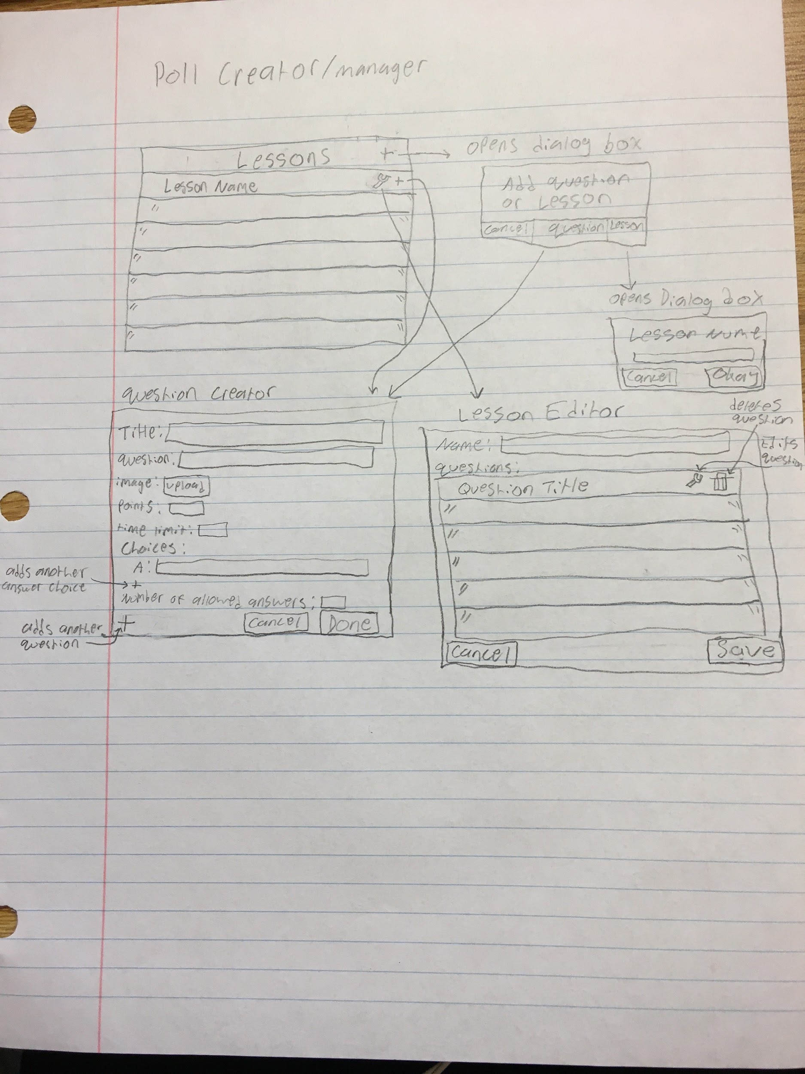
Notes:
Poll Creator/Manager teacher (nicholas)

Slide 12
Logo
Classes
User info
Create Class
Join Class
*active
CSCI 1100 - Computer Science I
CSCI 1200 - Data Structures
CSCI 2200 - Foundations of Computer Science
Create poll
View previous polls
View Code
Manage Users
Rename
Notes:
Classes Manager teacher
Annie
Hide create poll button if you don’t admin the class
Button arrangement TBD but probably rearrange auto by screen size

Slide 13
Logo
Classes
User info
Enter class code?????
Add Class
*active
CSCI 1100 - Computer Science I
CSCI 1200 - Data Structures
CSCI 2200 - Foundations of Computer Science
View previous polls
Remove class
Notes:
Classes Manager student
Annie
Reference slide 12 instead

Slide 14
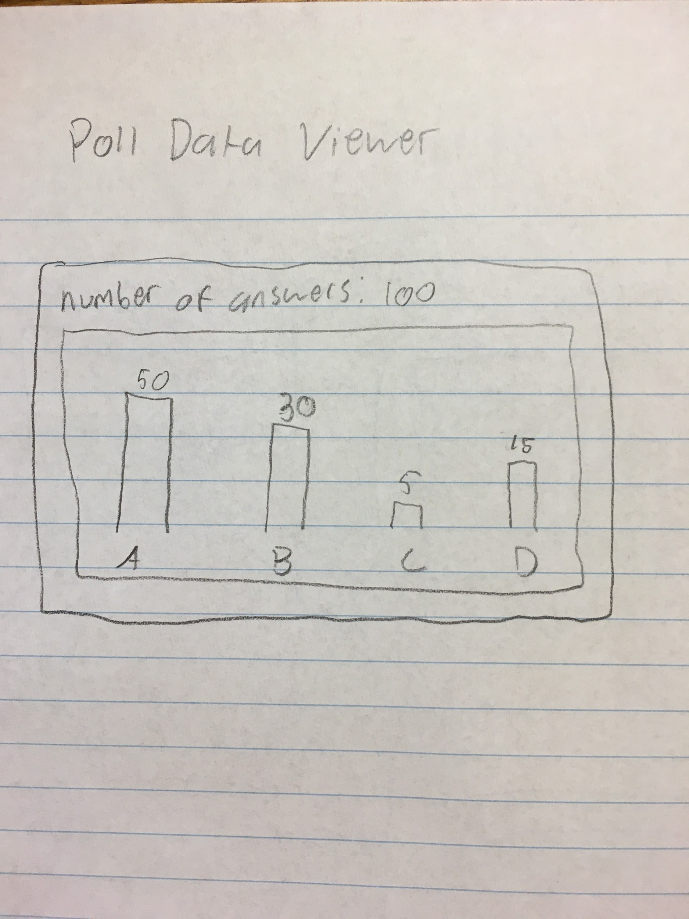
List of questions
DONE
Notes:
Poll data viewer teacher view (nicholas)

Slide 15
Logo
My Classes
User info
REMOVED
CSCI 1100 - Computer Science I
DO NOT NEED ANYMORE
(Don't delete)
CSCI 1200 - Data Structures
CSCI 2200 - Foundations of Computer Science
…
Notes:
Classes Student view- Ashwin

Slide 16
REMOVED
DO NOT NEED ANYMORE
(Don't delete)
Notes:
Classes teacher

Slide 17
Logo
Scores
User info
Classname
Poll1
Q1
Q2
Poll2
Poll3
Correct answers to that question with percents for each answer
If clicked classname/poll, show overall stats
Notes:
Student view scores for poll (Joe)

Slide 18
Logo
Class name
User info
Class info
Teacher
Amount of questions not finished
(stuff like that)
MERGED WITH 17
REMOVED
Notes:
Previous polls in that class student view (Joe)

Slide 19
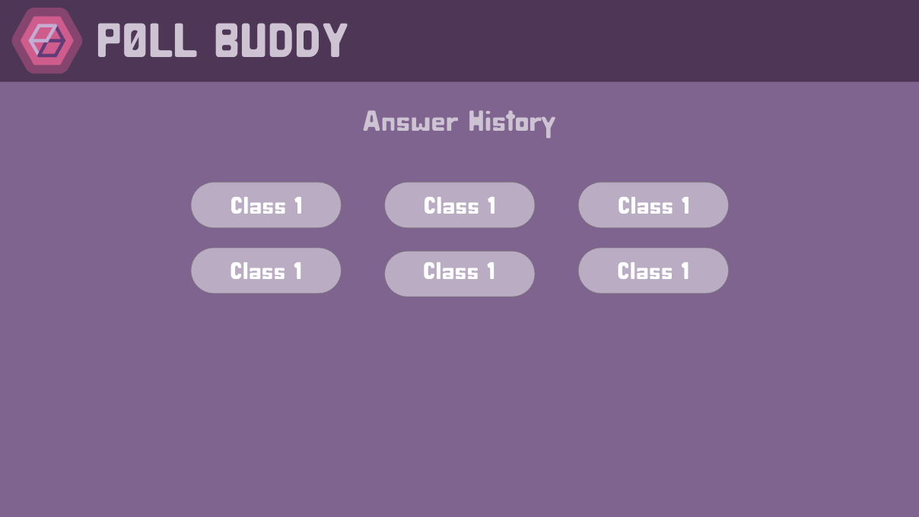
REMOVED
MERGED WITH 17
Notes:
Answer history
Student view
Kevin Cheng

Slide 20
MERGED WITH 17
REMOVED
Notes:
Teacher grading helper page

Slide 21
Change your Password
REMOVED
Current Password:
New Password:
Verify New Password:
Submit
Notes:
Change password
Ashwin

Slide 22
Logo
Settings
User info
Settings sections that change the box on the right
Settings in the section the teacher clicked
(
Dark/light mode
Account settings(change password)
Privacy policy
)
Notes:
Teacher settings (Joe)

Slide 23
Logo
Settings
User info
Settings sections that change the box on the right
Settings in the section the user clicked
MERGED WITH 22
REMOVED
Notes:
Student settings Joe

Slide 24
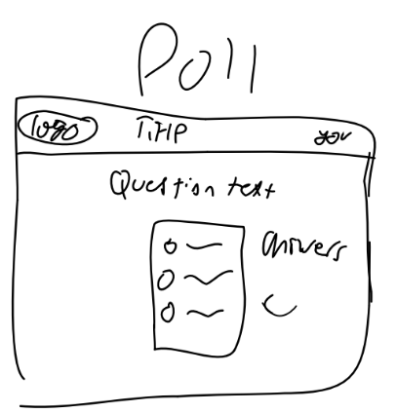
Logo
Poll
User info
Question 3 of 28:
Why does the tooth fairy collect teeth?
DONE
A
She grinds them into the fairy dust she needs to fly
B
She gives them to new babies who are ready to grow teeth
C
She gives the good teeth to dentists to make false teeth
D
She grinds them up and makes sand for the beach
Notes:
Polling page (Student View)
Annie

Slide 25
Basically say we don't use your data for anything in nice words
DONE except for the wording of our privacy policy
Notes:
Privacy

Slide 26
Logo
Register
Login
DONE
Register with School
Register with PollBuddy
Notes:
Login School has a
Neha
When you log in with an rpi email it sends you to the rpi login page on the rpi website

Slide 27
Logo
Register (School)
Login
DONE
Enter school name
Submit
CAS
Notes:
Login School has a
Neha
When you log in with an rpi email it sends you to the rpi login page on the rpi website

Slide 28
Logo
Register (PollBuddy)
Login
DONE
Name
Email
Password
Submit
CAS
Notes:
Login School has a
Neha
When you log in with an rpi email it sends you to the rpi login page on the rpi website

Slide 29
Logo
Forgot Password
Login
DONE
Email
Submit
Notes:
Forgot password (enter your email)
Neha

Slide 30
Logo
Reset Password
Login
DONE
Security code (link autofilled)
New Password
Retype password
Submit
Notes:
Forgot password (you get here after you click the link in your email)got Password (after you got the reset email
Neha

Slide 31
About Us (link)
Questions, Comments, etc? Email us: someemail@yeah.com
RCOS LOGO
Github LOGO
Notes:
footer

